Slide 1
Updates and Reminders
Recruiting (trained) PLAs for Cell Bio in D term
Help run study sessions before quizzes
Assist with active learning workshops 4 times during the term (Class is 12-1pm in Foisie 203/205)
Capstone course (BB4900) on Genome Stability to be offered C term 2021
Final Primary Literature Workshop (#4) on Monday – paper and worksheet available by the end of the day
Final Lecture and Extra Credit opportunity on Tuesday

Slide 2
Lecture 16 objectives
Understand and be able to describe 7 key steps in metastatic progression
Appreciate the challenges cancer cells face at each step and how these challenges limit the realization of a metastatic tumor
Consider how changes within the cancer cell and within the tumor microenvironment impact each step in the process

Slide 3
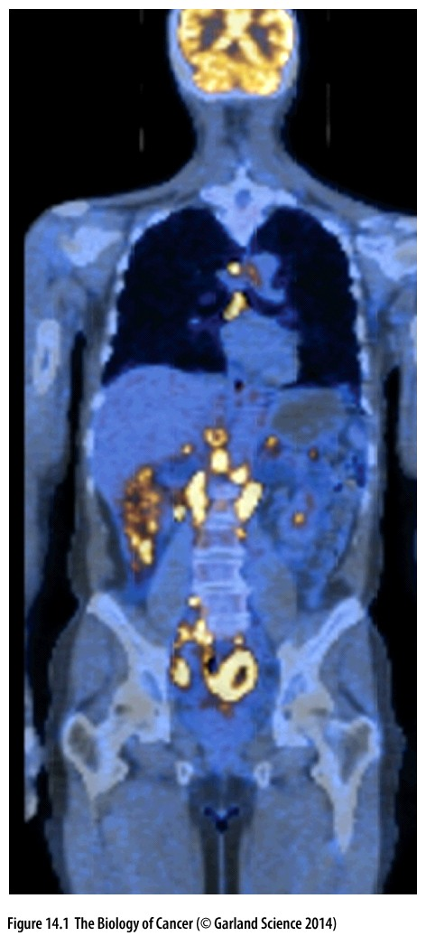
Metastatic progression: an unsolved problem in cancer pathogenesis
Primary tumors may grow large enough to compromise function of the tissue in which they reside, but account or only 10% of cancer death
90% of cancer deaths are from metastatic disease
Metastases: cancer cells that have left the primary tumor, traveled through blood or lymphatic vessels and colonized at distant sites
Metastatic colonization compromises vital tissue functions
Many questions remain about when and how cancers become metastatic

Slide 4
Metastatic progression: an unsolved problem in cancer pathogenesis
Deduce what events might be required for progression from primary to metastatic tumor
Hint: start with a small tumor- what comes next? 7 steps leading to a growing metastatic tumor…
Consider which steps are likely influenced by cell autonomous (ie mutations or gene expression changes) and which are cell non-autonomous (ie influenced by the microenvironment)

Slide 5
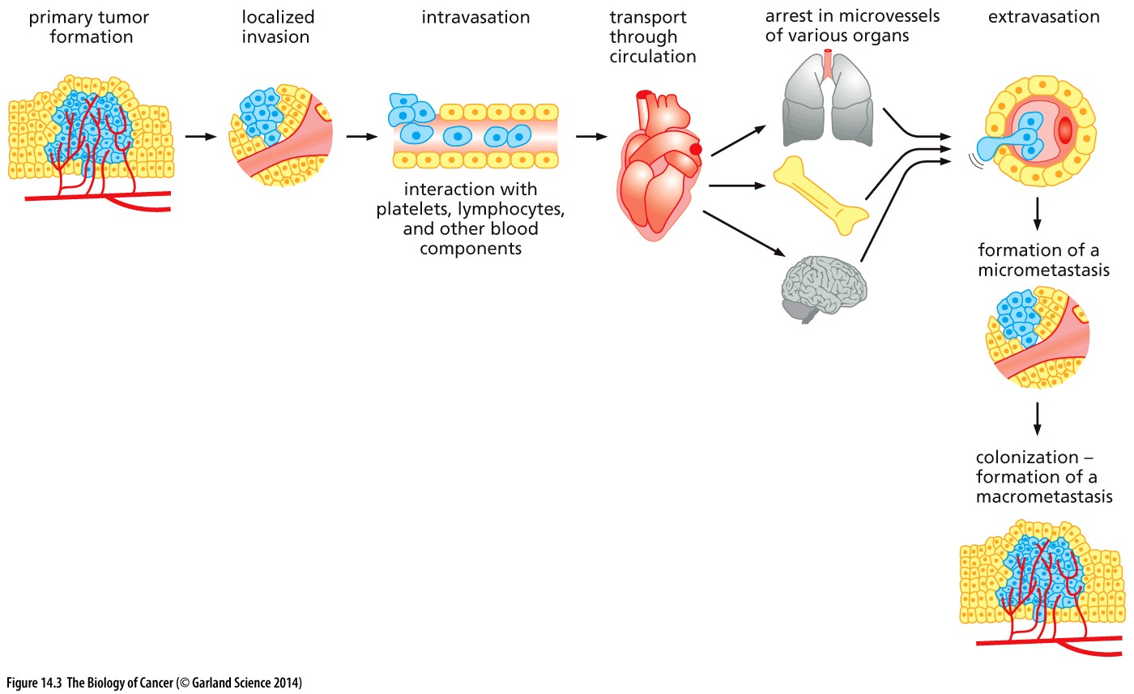
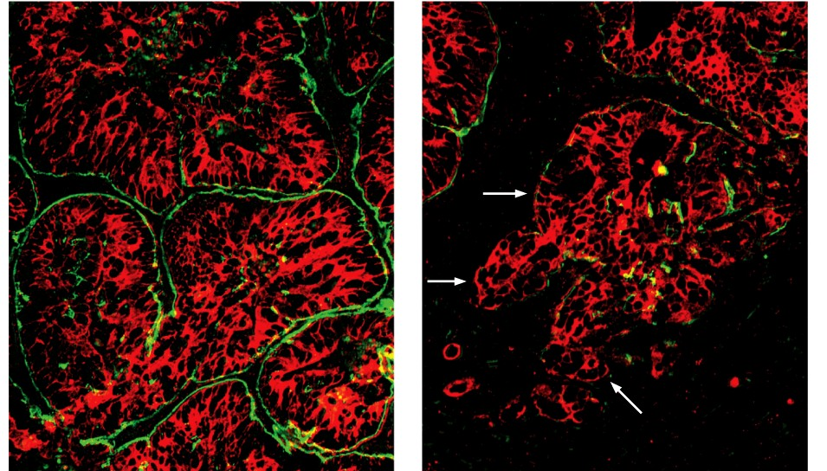
Invasion-metastasis cascade
Biochemical and biological changes within cancer cells can permit them to become metastatic
Primary tumor grows & promotes angiogenesis to sustain the tumor
localized invasion: remodeling of the extra cellular matrix allows cancer cells to breach the basement membrane (specialized ECM)
Basement membrane separates epithelial cells from the stroma
Loss around a tumor mass correlates with incidence of metastases
Cancer cells gain direct access to blood and lymphatic systems

Slide 6
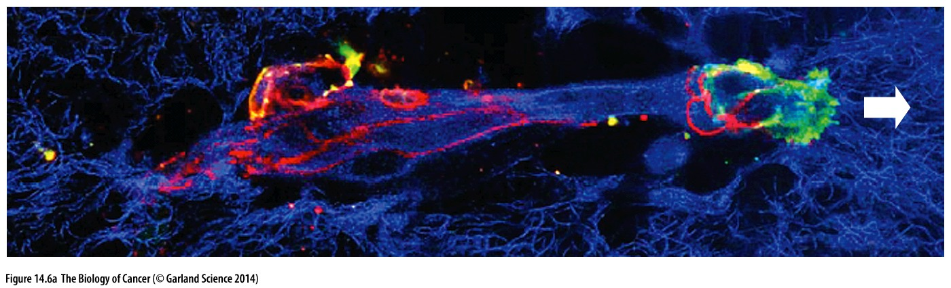
ECM degradation to lead the way!
Expression of matrix metalloproteases (MMPs) to further corrupt the ECM and disrupt cell-cell adhesion → permits EMT: epithelial cells become more mesenchymal-like (motile)
Cancer cell clumps attach to intact matrix via integrins and release localized MMPs to degrade the matrix
Co-opt stromal cells to ‘clear a path’ and the cancer cells follow behind

Slide 7
Invasion-metastasis cascade
Angiogenesis
Localized invasion
Intravasation: cancer cells break away from the tumor & gain access to the circulatory system through leaky capillaries or faulty lymphatic vessels

Slide 8
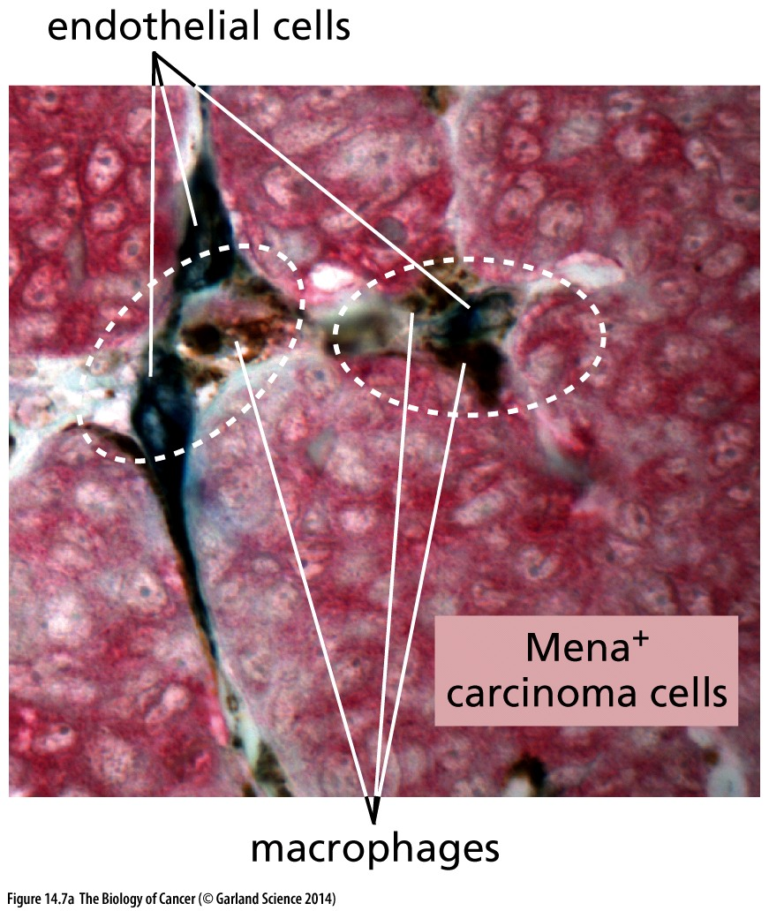
Intravasation
Mechanism still not well understood
Carcinoma cells, macrophages and endothelial cells must complex to promote intravasation
Presence and number of triads is an indication of metastatic potential
Higher triad density = strong indication of eventual metastases

Slide 9
Invasion-metastasis cascade
Angiogenesis
Localized invasion
Intravasation
Transport

Slide 10
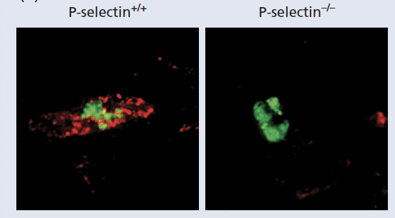
High risk travels and hitchhikers
Circulating tumor cells (CTCs) often die upon intravasation
may still be anchorage-dependent (epithelial cells are) → anoikis: apoptosis triggered by detachment from solid substrate
No longer have stromal support (mitogenic and trophic factors supplied by the stromal)
Shear forces tear them apart → they are HUGE compared to blood cells that normally navigate capillaries
Metastasizing cancer cells travel with small clots of platelets or red blood cells to protect them

Slide 11
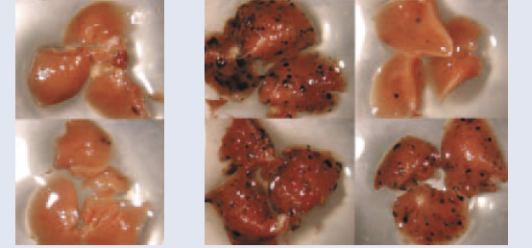
High risk travels and hitchhikers
Circulating tumor cells (CTCs) often die upon intravasation
may still be anchorage-dependent (epithelial cells are) → anoikis: apoptosis triggered by detachment from solid substrate
No longer have stromal support (mitogenic and trophic factors supplied by the stromal)
Shear forces tear them apart → they are HUGE compared to blood cells that normally navigate capillaries
Experimentally eliminating platelets or compromising the ability of platelets to interact with carcinoma cells dramatically reduces successful metastatic events
No platelets With platelets

Slide 12
Invasion-metastasis cascade
Angiogenesis
Localized invasion
Intravasation
Transport
Extravasation
Most CTCs never make it out of the blood system
Extravasation has never been viewed

Slide 13
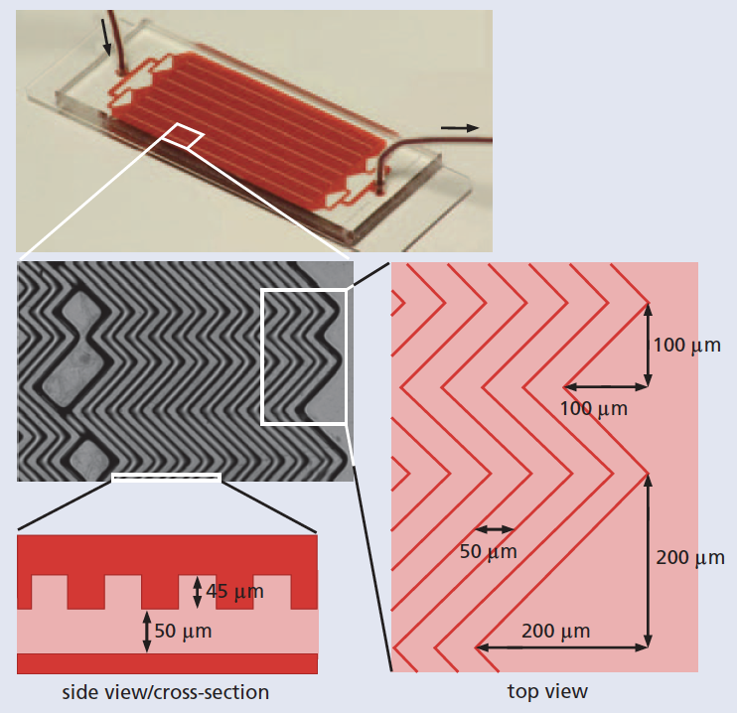
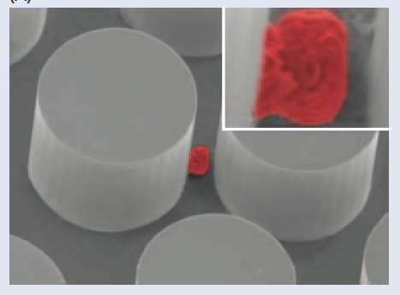
Studying CTCs to understand metastasis
Specially designed instruments facilitate the capture and study of CTCs
Microfluidic devices force cells through single-file
Antibody-coated surfaces ’catch’ cancer cells circulating in the blood
# of CTCs can be used to monitor disease progress
CTC’s can be released and collected for study
What can CTCs tell us about metastases
What might they NOT be able to tell us?

Slide 14
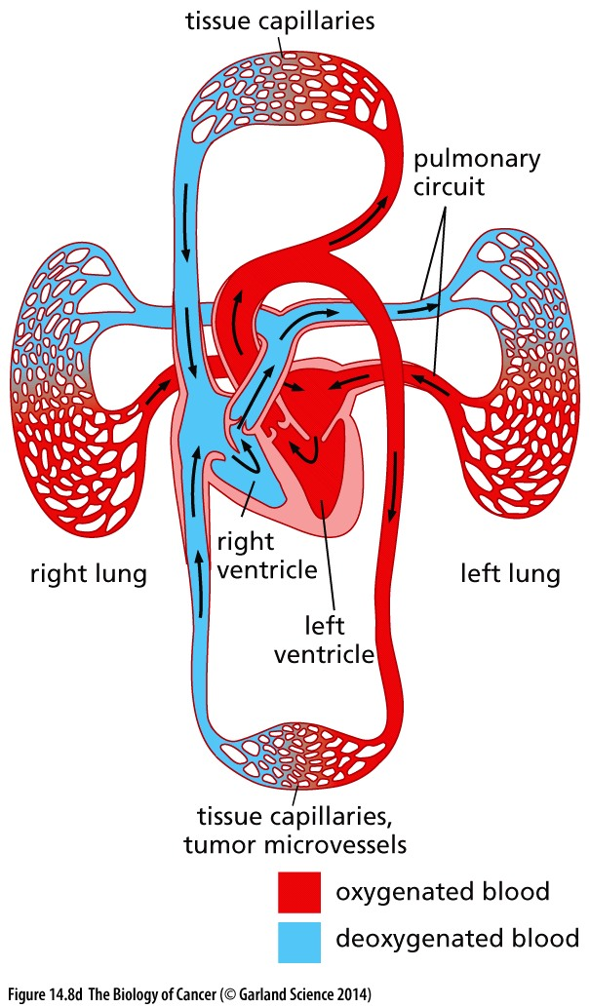
A short ride
Blood leaving a tissue gets shuttled to the lungs via the heart within minutes
CTCs may get trapped in the lungs
common site of metastases
But many CTCs escape the lungs to found metastases elsewhere
How is this possible?

Slide 15
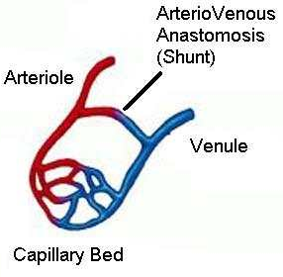
Setting up home
Pathway to distant sites remains unclear
‘amputate’ cytoplasm to make themselves smaller?
Bypass capillaries altogether and use “(bigger) AV shunts?
Getting ‘stuck’ may be the first step to initiating a metastatic tumor

Slide 16
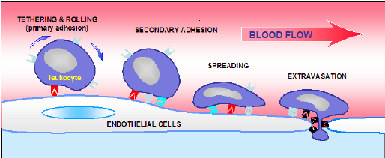
Let me out (in?)
Blood cells pass through the capillary endothelial cells by diapedesis → takes minutes and the capillary is left unharmed

Slide 17
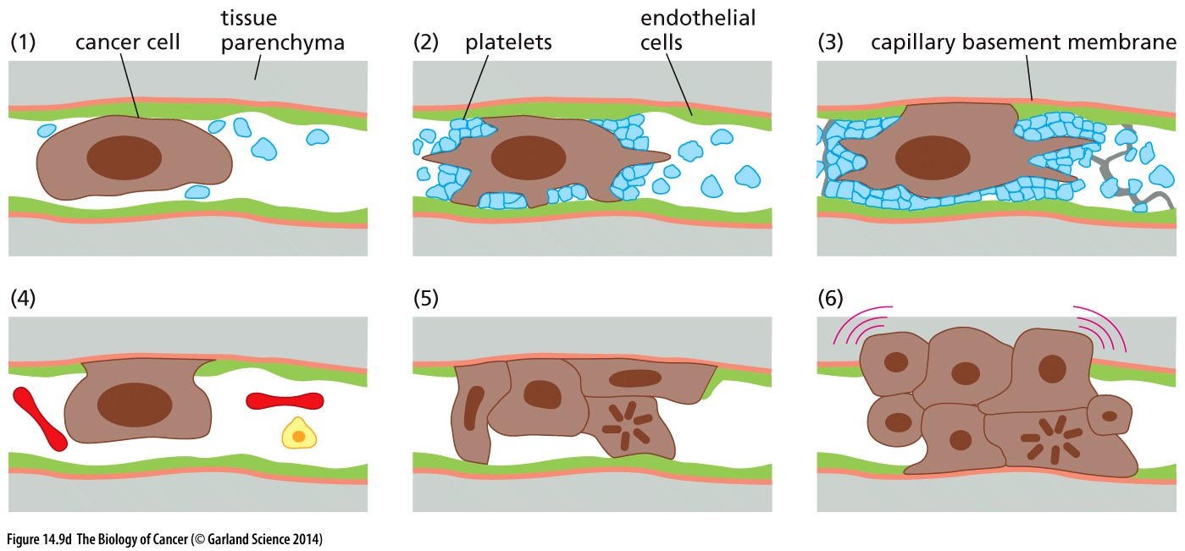
Let me out (in?)
Cancer cells may lack appropriate receptors and so push through by brute force → can take hours or even days
Association with platelets may sustain EMT behavior → useful when navigating out of the blood vessel into a tissue
May co-opt macrophages to help clear the way

Slide 18
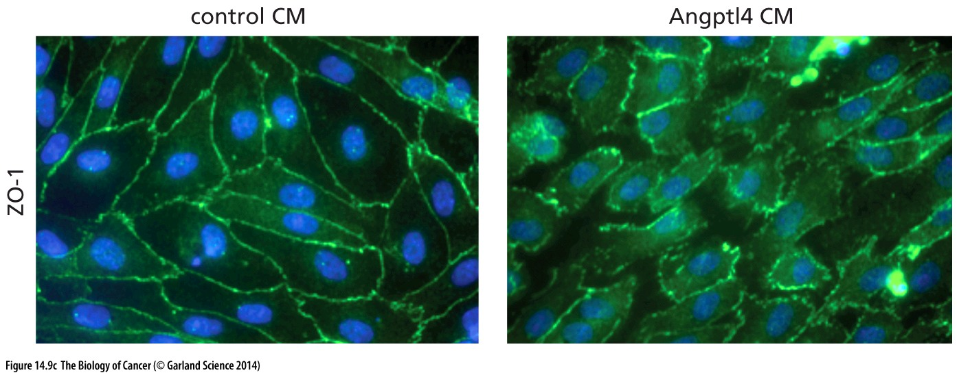
Let me out (in?)
Some cancers excrete proteins that induces endothelial cells to retract from each other
Vessel’s basement membrane is exposed → cancer cells excreting MMPs can break through
Tight junctions/cell –cell contacts

Slide 19
Invasion-metastasis cascade
Angiogenesis
Localized invasion
Intravasation
Transport
Extravasation
Micrometastasis formation

Slide 20
Micromatasteses: cancer cells or small clumps that make it out of the circulatory system
Odds are still against cancer cell survival → many that survive to this point never succeed in initiating new tumor growth
Lacks a nutrient-rice environment
Must initiate tumor formation and angiogenesis anew
Growth is likely suppressed by immune system
Micromatasteses may not be detectable & may never divide again to progress to form secondary tumors
Organs transplanted into immunocompromised patients that contain micrometastases can quickly progress into large tumors
Tumor are derived from the primary tumor in the donor
Organs from the same donor in multiple recipients are of the same clonal origin
tumors from organs of 153 donors (out of 300,000 transplants)

Slide 21
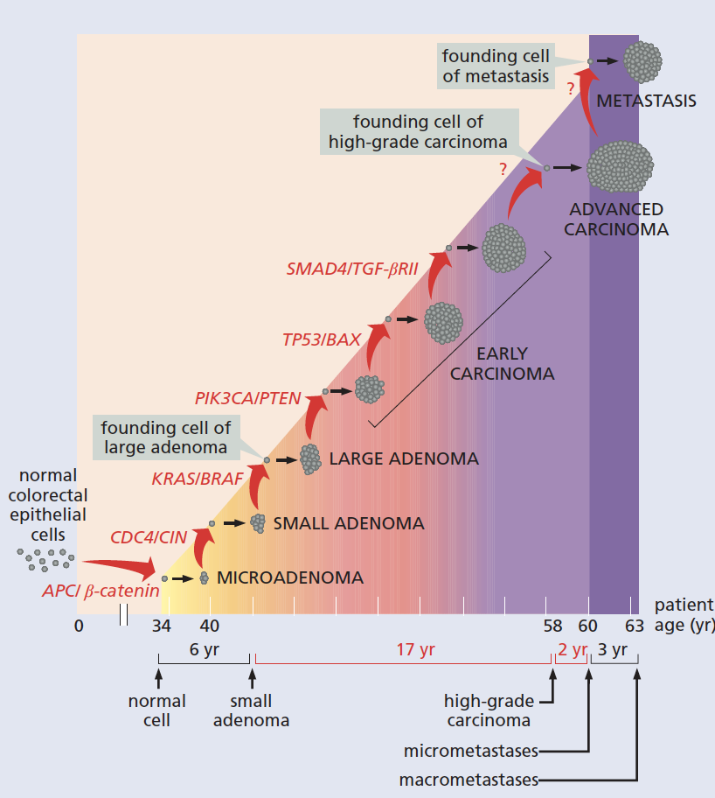
Tumor timing
Large scale sequencing of cancer genomes & experimentally measured random mutation rate → timing of tumor progression
Primary tumor formation: heritable genetic and epigenetic changes
Activation of EMT →CTCs → micrometastases
Colonization
#1 &2 may not be genetically different!
Tumor cells are ‘born’ with EMT capabilities?

Slide 22
Invasion-metastasis cascade
Angiogenesis
Localized invasion
Intravasation
Transport
Extravasation
Micrometastasis formation
Colonization
Those that survive move on to the most challenging step…
Rate-limiting determinant:
# of micrometastases vastly exceeds those that will grow to be clinically detectable

Slide 23
Making a hospitable home
Experimental models show:
Millions of CTCs may result in only a handful of metastases
Many micrometastases are non-proliferative/dormant
Cancer cells must re-establish the supportive stroma they left behind:
PDGF and fibroblasts → proliferation
MMPs and myofibroblasts → ECM remodeling
VEGF and Macrophages → angiogenesis
Colonization often initiates near blood vessels

Slide 24
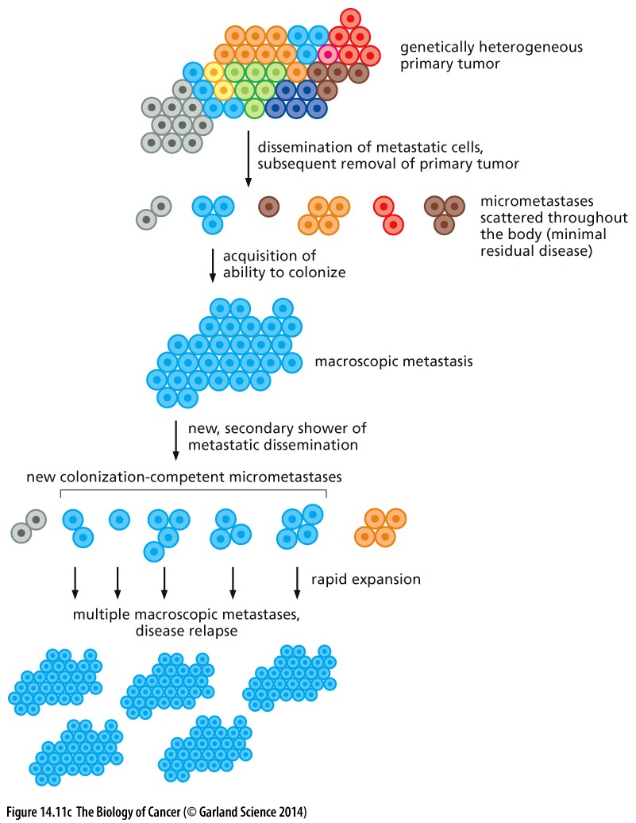
Colonization
Cancer cells continue to acquire mutations
Evolution of a micrometastasis promotes colonization
can give rise to new CTCs that will be much more efficient at colonizing and forming secondary tumors
Acquisition of ability to colonize is tied to proliferation. WHY?

